Slide 1
Игра – викторина по английскому языку «We like English»

Slide 2
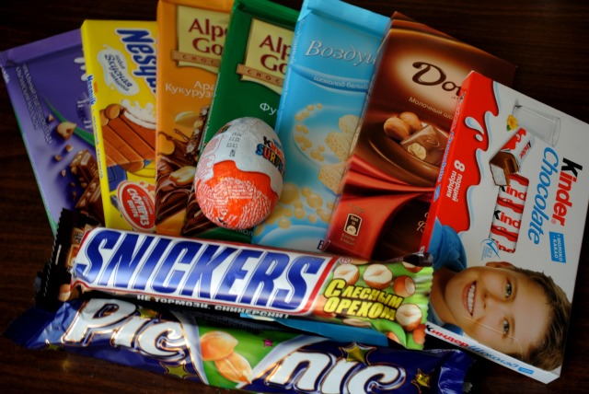
1 competition "Chocolate"
Snickers, Mars, MilkyWay, Dove, Alpengold, Felicita, Kindersuprise,Ritter Sport,Milka, Alpenmilch.

Slide 3
2 competition "Bag of a tourist"
Bread, sausage, cheese, apples, tomatoes, cucumbers, potatoes, onions, carrots, tea, sugar

Slide 4
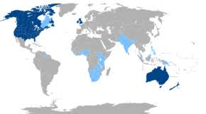
3 competition "Music Box"
1 отрывок – Jordan Jansen«Halleluja» - “Shreck”
2отрывок – Elton John «Can you feel the love tonight» - “King lion”
3 отрывок – Celine Dion «My heart will go on» -„Titanic“
4 отрывок – Real 2 real «I like to move it» - «Madagascar»

Slide 5
4 competition "Transport"
TAIRPLANESTUCAMOЛЕТNABFLUGZEUGISTJ
FRAЛОДКАMMUXBOATTNIJBOOTFGYPAOBNI
SCHIFFOLRESHIPTVZКОРАБЛЬOTHOSAPMEW
XYZZUGIGHTTRAINПОЕЗДRSDRBOEFANMOM
DEFПАРОМSPULFERRYSPWFÄHREZURHOATI
LMNOKUTSCHEWYKLКАРЕТАPYGCOACHMKI
ВЕЛОСИПЕДNJRLPFFAHRRADLMNOBICYCLE
VCARBXАВТОМОБИЛЬDFYZTAAUTOICUPDB
АВТОБУСHIJBREBUSDOVWFRBUSTUCKLYUC

Slide 6
5 competition "Countries of the studied language"
Canada | Wellington
England | Ottawa
the USA | Cardiff
Scotland | Belfast
Australien | London
Northern Irelad | Washington
New Seeland | Canberra
Wales | Edinburg

Slide 7
6 competition "Countries of the World"
T | G | S | V | B | G | R | E | A | T | B
U | E | L | M | K | Q | Z | B | U | O | R
R | R | U | S | S | I | A | C | I | W | I
K | M | I | P | Y | X | V | I | T | E | T
E | A | U | C | H | S | P | A | I | N | A
Y | N | P | H | A | E | P | B | L | Q | I
V | Y | B | I | T | K | O | A | Y | E | N
M | R | W | N | B | J | O | A | I | X | M
T | H | A | A | E | N | G | L | A | N | D
B | R | A | Z | I | L | U | S | A | I | L

Slide 8
7 competition Continue the lines of words:(6)
Monday,
Green,
Australia,
A dog,
March,
Mother,
Lemon,
Two,
Kind,

Slide 9
8 competition «Unscramble»
eHwlenaol
nlEishg
oseHu
amNe
oLdonn
Ccolk

Slide 10
9 competition "The Best Reader"
When the weather is wet
We must not fret, -
When the weather is cold
We must not scold.
When the weather is warm
We must not storm, -
But be thankful together
Whatever the weather.

Slide 11
10 competition "A connoisseur of proverbs and sayings"
No new – is a good new
Live and learn
Health is better than wealth
It’s never too late to learn
A bird may be known by its song.
After rain comes fine weather.

Slide 12
11 contest "Extraordinary word"
Easter, Christmas, St Valentine’s Day, Columbus
Tea, coffee, juice, lemon
Swimming, hockey, moving, football
Dress, T-shirt, suit, boots
Tree, sun, rain, cold

Slide 13
12 contest "Fill in the missing letters"
w…ather
C…rist…as
L…ndon
Ameri…a
Te…cher
Sch…ol
Pres…dent
Footb…ll

