Slide 1
English lesson
8 "b" class
Teacher: Usanina G.V

Slide 2
Psychological attitude
Division into 2 groups:
assemble the puzzle.

Slide 3
I'll give you sheets of self-evaluation: for every correct answer put 1 point

Slide 4
Checking homework: checking answers to a crossword puzzle.
C

Slide 5
Let’s watch the video

Slide 6
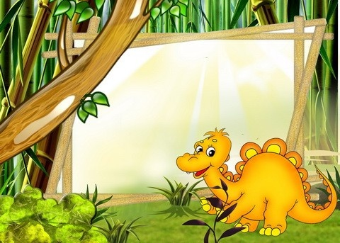
Theme Dinosaurs.
Why did they disappear?

Slide 7
Aims:
Organize and synthesize the knowledge of pupils on the theme
Develop the skills of listening, reading and speaking on the theme
Develop the interest of lOrganize and synthesize the knowledge of pupils on the theme
Develop the skills of listening, reading and speaking on the theme
Develop the interest of learning English.
-Creating an atmosphere of creative interaction between pupils earning English.
-Creating an atmosphere of creative interaction between pupils

Slide 8
New Words
dinosaur-[ ˈdaɪ.nə.sɔːr ]- динозавр
-vegetarian-[ ˌvedʒ.ɪˈteə.ri.ən ]- вегетарианец
-to disappear-[ ˌdɪsəˈpɪə(r) ]- исчезнуть
-theory-[ ˈθɪəri ]- теория
-comet-[ ˈkɒm.ɪt ]- комета
-asteroid-[ ˈæs.tər.ɔɪd ]- астероид
- herbivores ˈ[ hɜːbɪˌvɔːz ] - травоядные
-predatory [ ˈpred.ə.tər.i ]- хищные

Slide 9
Task 1
Work with cards. you need to find 15 words on this topic
Pair work
Armor. Dinosaurs. Eggs. Extinct. Carnivore. Plates. Spikes. Jurassic. Fossil. Horns. Museum. Triassic. Trice raptor. Stegosaurs. Trice raptor.
Descriptors
A learner:
-look at the letters
-find words
-evaluate yourself

Slide 10
Work in group
Determine who is in your group leader, who is the secretary, who will monitor the time, who will evaluate.

Slide 11
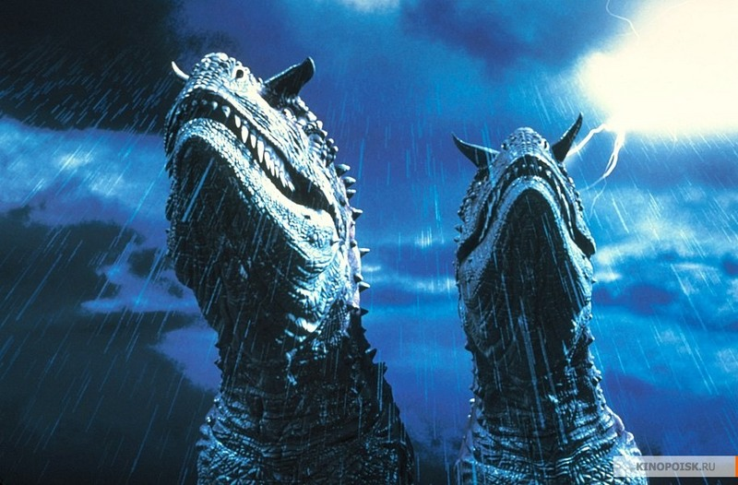
Group 1
Create a poster using pictures on the theme: "The Age of Dinosaurs" and describe it.
Descriptor:
Student
view pictures
create a poster- describe this era

Slide 12
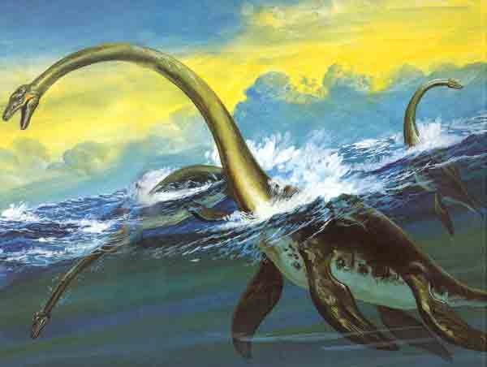
Group 2
;
Create a poster with pictures on the theme: "Types of dinosaurs" and describe it
Descriptor:
Student
- view pictures- create a poster
describe types of dinosaurs

Slide 13
Physical exercise

Slide 14
Individual work
What is compound words?
Differentiated task
1. All perform
2. Doing 3 sentences
3. Translate compound words
Descriptor:
Student
-Read
-Apply the rule "Compound words"

Slide 15
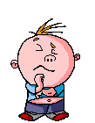
Answer the questions:
Read and translate text Ex 1 p 166
When did dinosaurs live on the Earth?
What were they?
How does the climate change theory explain the dinosaurs on the Earth?
What does the second theory say?
What kind of dinosaurs do you know?

Slide 16
Hand over sheets of self-evaluation

Slide 17
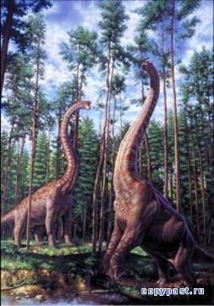
Before you, "Stairs of Success." If you do not understand at the lesson, you glue the dinosaur on the lower staircase if you understand but not everything is on average and if everyone understood and liked the lesson on the upper ladder

Slide 18
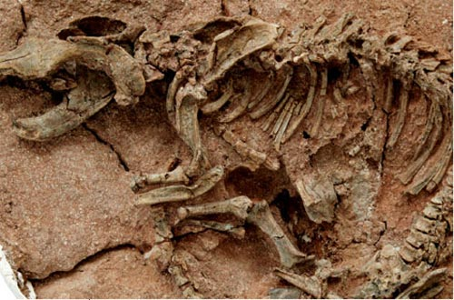
Homework
P 168 test
p 168 (test)

Slide 19

Thank you for attention!
!

